Slide 1

Haiku maker
Jussi-Pekka Martikainen, Miika Leinonen, Kimmo Kauria

Slide 2
What is a haiku?
Japanese poem
Three phrases with 5-7-5 syllable structure
No rhyming
Traditionally refers to nature or seasons
Contains a cutting word that splits haiku to create juxtaposition between the two parts (not implemented)
must distribute hard
us might consider much it
may indemnify

Slide 3
Haiku producing overview
Generation-evaluation loop
First generate a bunch of random haiku
Only restriction 5-7-5 syllable structure
Evaluate these haiku and return scores to generator
Generator makes new better haiku based on the top scoring haiku
Evaluate these new haiku, continue...
whatever thump must
choke electronically
it might proceed down

Slide 4
Generation
Only one fixed rule, syllable counts must be 5-7-5
First step, generate a bunch of haiku
Basically just pick random words from corpus to make lines of length 5, 7 and 5
Let evaluator score them
Pick the top scoring haiku (plural)
Make a Markov chain of top scoring haiku’s part-of-speech tags
before office stool
royalty royalty i
know all copyright

Slide 5
Generation
In the next generation cycle select word types using Markov chain
Select a word from corpus in the chosen word type category
Make sure the word doesn’t put the line over its syllable limit
If it does, choose a new word
If a word of with suitable syllable count can not be found in chosen category, pick a new category
why authority
anger distribute includes
intellectual

Slide 6
Generation
Using this method of picking words, again generate a bunch of haiku
Evaluate -> New Markov from top scoring haiku -> New batch of haiku -> ...
whatever nonsense
underneath down sky hedgehog
agony a goals

Slide 7
Corpus
Text to get topic and lexicon
Must be large because we need many words in all word type categories with varying syllable counts
Easy for generator to pick a word type and get a list of words with different syllable counts
Removed uppercases, dots, commas etc.
i know any care
takes uncomfortable pope
damage person soon

Slide 8
Corpus
Can use different source texts and basically make haiku about anything
Could be made to use texts with different topics and mix them to get interesting results
more us faces nay
identification must
convert much us ca

Slide 9
Evaluation
Extremely simple
Based on 18 high quality Japanese haiku translated into English
Syllable count doesn’t follow 5-7-5 structure
Assume the part-of-speech structure of these poems is ideal
Compare to generated haiku’s pos structure
uncomfortable
solicitation do seems
really underneath

Slide 10
Evaluation
The better they match, the better the score
Calculated by finding the longest common pos substring between any example haiku and the generated haiku
Other structural evaluation ideas:
Somehow check if it makes sense for subsequent words to appear together
Make sure lines or at least last line ends in a reasonable word
computers follow
gone considering awhile
each authority

Slide 11
Evaluation
Evaluation based on the actual meaning of the words
Would have helped in scoring juxtaposition
Not enough time
Each generation had at least few high scoring haiku, but the mean score increased with each iteration
mine bit together
throughout alteration est
matters hall fetch milk

Slide 12
Ventura mere generation
knife decomposing
rabbit milk no many need
greasy whole sprinkle
so underneath drunk
considering either much
over might better

Slide 13
Example haiku using cooking text
Randomly generated haiku
almost meat butter
whatever expended eggs
ahead animals
overnight eggs taught
intelligently merit
thicken showing yes
lemon increases
paprika accumulate
characteristics
5th generation haiku
thanksgiving bloody
yolk congeniality
fry baked upright lord
oh outside damp best
americans select sound
over excess kills
objectionable
no experimentation
together cores deemed
10th generation haiku
any healthy hairs
peculiarities pray
who differently hay
accumulate lie
add predominant escape
wipe obliterate
apologizes
attach meet insatiable
milk perfectly nice

Slide 14
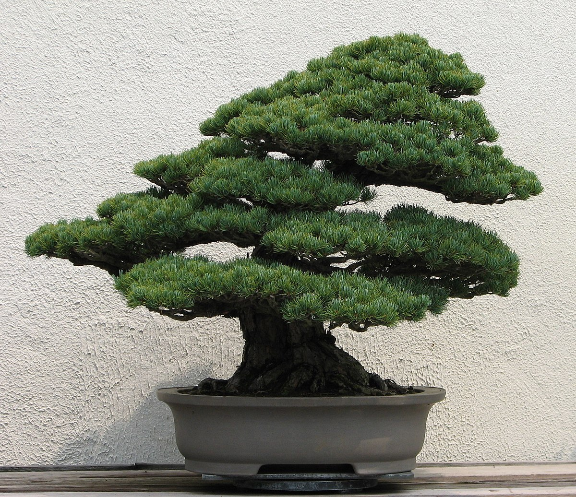
Fin
its information
consider two rats quarrel
discovered brushing

Slide 15
me brains swiftest burnt
hem pit might carry thicken
indies gelatine
educational
well particularly out
all languid takes off

Slide 16
thrust nose cucumber
lest mexican failure weigh
pile thanksgiving kiss
stupidest place think
considering cause any
such reason above

